Slide 1


Marine litter
Подготовил: учитель английского языка II категории
Гадельшина Гульфия Агтасовна

Slide 2
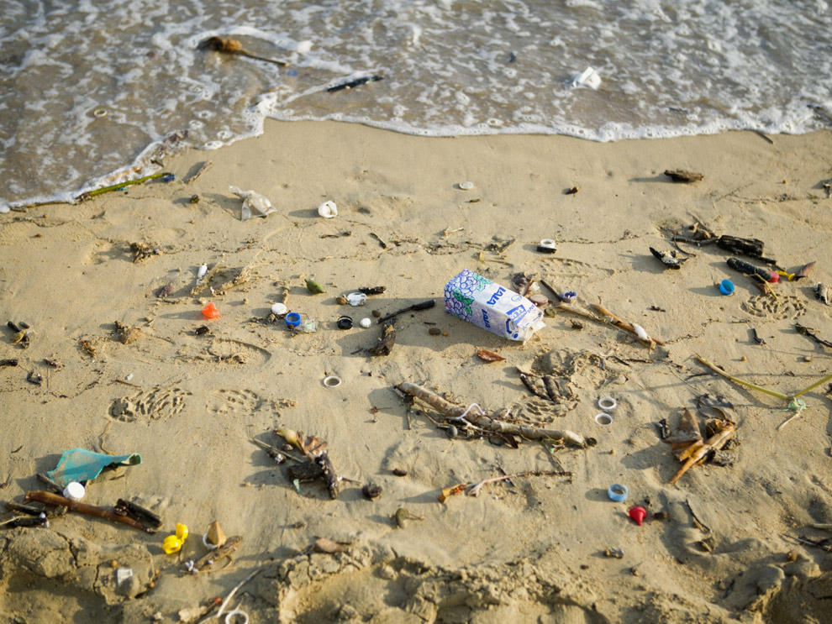
How are the following related to the text? Read and translate:
Broken glass – There might be broken glass in the sand and I can not see it. It would be very dangerous for the people on the beach.
Fishing net – Sometimes you can find pieces of fishing nets on the beach. It makes the beach look very dirty. They can injure animals, too.
Drinks cans – People drink soft drinks from cans and not everyone throws them in the bin when they are finished.

Slide 3
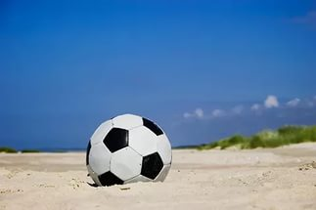
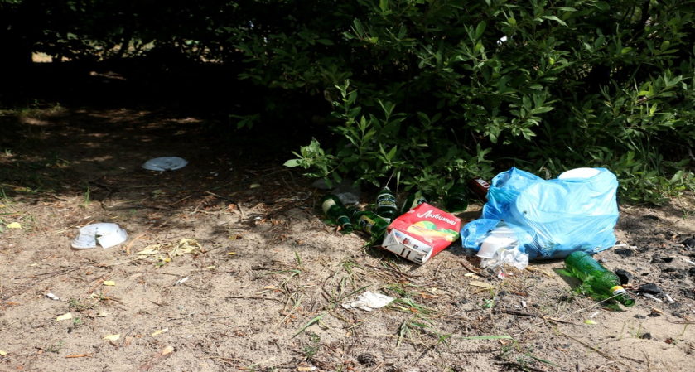
- Plastic bags – People bring food in plastic bags. If they leave them behind they are dangerous to animals.
- Plastic buckets and spades – People use them to build sandcastles but they can be left behind very easily. Sometimes you can find them lying on the beach, making it very untidy.
-Beach balls – Another fun toy you can find on any beach. When they burst, nobody wants them and they are left behind on the beach.
- Food wrappers – People often leave them behind causing litter.

Slide 4
Сhoose the right answer
-They say you have an environmental awareness day at school today. What does it mean?
-It’s a special day when we learn what we 1)don’t have to/should do to protect the environment. You know, how we 2)can/mustn’t help to save the planet.
-That sounds interesting. What do you do?
-Well, for a start, everybody 3)should/can’t walk or cycle to school to save energy. And we 4)mustn’t/must make sure we don’t waste energy.
-I see. Besides, we 5)ought/should recycle paper, glass and plastic.
-You are right. I think you 6)had better/have to have an environmental awareness day at your school, too.

Slide 5
Check your answers:
-They say you have an environmental awareness day at school today. What does it mean?
-It’s a special day when we learn what we 1)should do to protect the environment. You know, how we 2)can help to save the planet.
-That sounds interesting. What do you do?
-Well, for a start, everybody 3)should walk or cycle to school to save energy. And we 4) must make sure we don’t waste energy.
-I see. Besides, we 5) should recycle paper, glass and plastic.
-You are right. I think you 6)have to have an environmental awareness day at your school, too.

Slide 6
Look the video. Answer the question:
What can we do else to protect the environment?

